Slide 1
5. Trade can Make Everyone Better Off
AIM:
DO NOW: In your notebook write briefly about an example from your life where you benefited from an exchange of something with another person?

Slide 2
If your family were isolated from other families/society, it would not be better off. It would need to grow its own food, make its own clothes, and build its own home.
Clearly, your family gains much from its ability to trade with others. Trade allows each person to specialize in the activities he or she does best, whether it is farming, sewing, or home building. By trading with others, people can buy a greater variety of goods and services at lower cost.

Slide 3
5. Trade can make everyone better off.
For the Video that plays here, please click on the separate link for
CAVO-NOMICS
Notes:
Never make for yourself something that would cost more to make that it would if you bought it from someone else
Example: My bookcase story.

Slide 4
6. Markets are usually a good way to organize economic activity.
Notes:
Market – any arrangement that brings buyers and sellers together to do business with each other.
Markets-coordinate-trade principle: if markets operate FREELY without government intervention then it benefits everyone - sellers will make a fair profit and buyers will not overpay for products.
Adam Smith – “The Invisible Hand” - describe aspects of self-regulating behavior in a marketplace. suggest that the forces that drive a market will soothe social ills and maximize wealth without the need for outside regulation
The idea of markets automatically channeling self-interest toward socially desirable ends is a central justification for the laissez-faire economic philosoph

Slide 5
In a market economy, the decisions are made by millions of firms and households. Firms decide whom to hire and what to make. Households decide which firms to work for and what to buy with their incomes. These firms and households interact in the marketplace, where prices and self-interest guide their decisions.

Slide 6
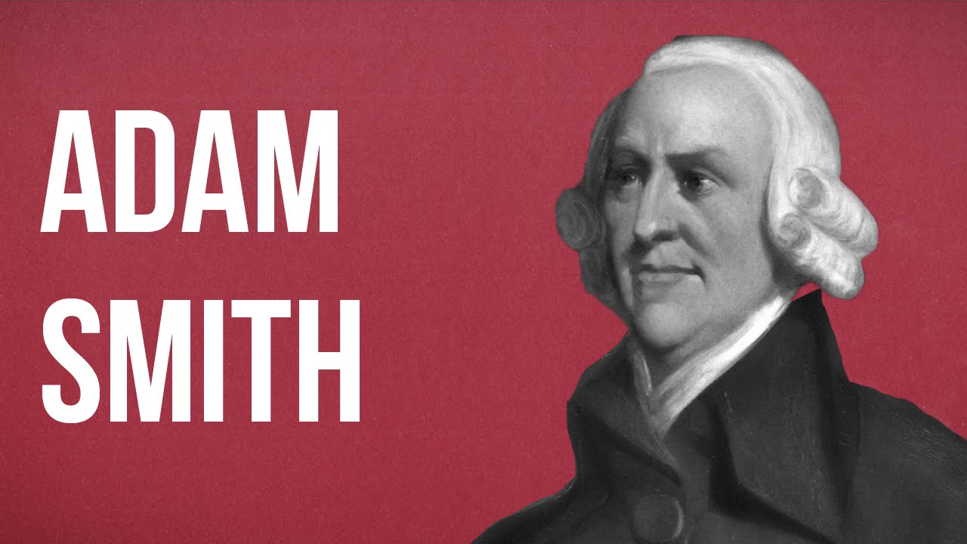

Slide 7
For the Video that plays here please click the separate link for
Markets Video

Slide 8
For the Video that plays here please click the separate link for
Adam Smith video

Slide 9
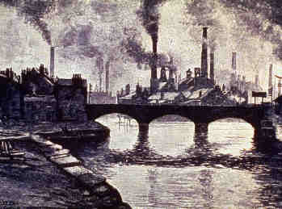
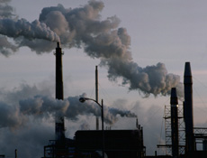
7. Future consequences count.
Notes:
The Decisions that we make today often have long-tern consequences. An economist should not just look at the immediate effects of actions, but at what it will cost in the long term.
EXAMPLE:
Our company can make a lot more money if we don’t pay any attention to those silly air pollution laws !
What might the long ten effects be of this?
- health problems = health costs
- quality of life – the place I live is ugly and unhealthy
workers leave for some place else to work and live.
gov. fines add up.

